Slide 1
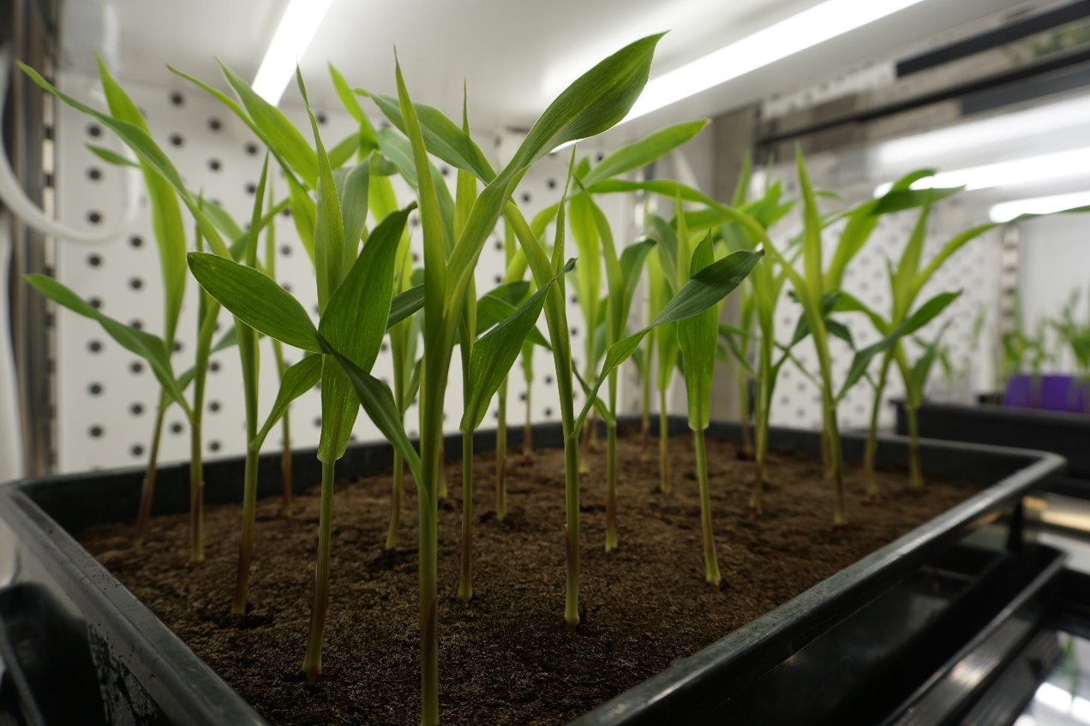
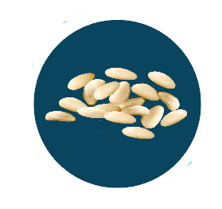
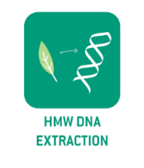
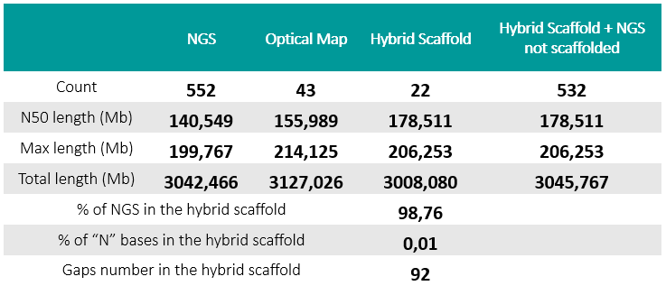
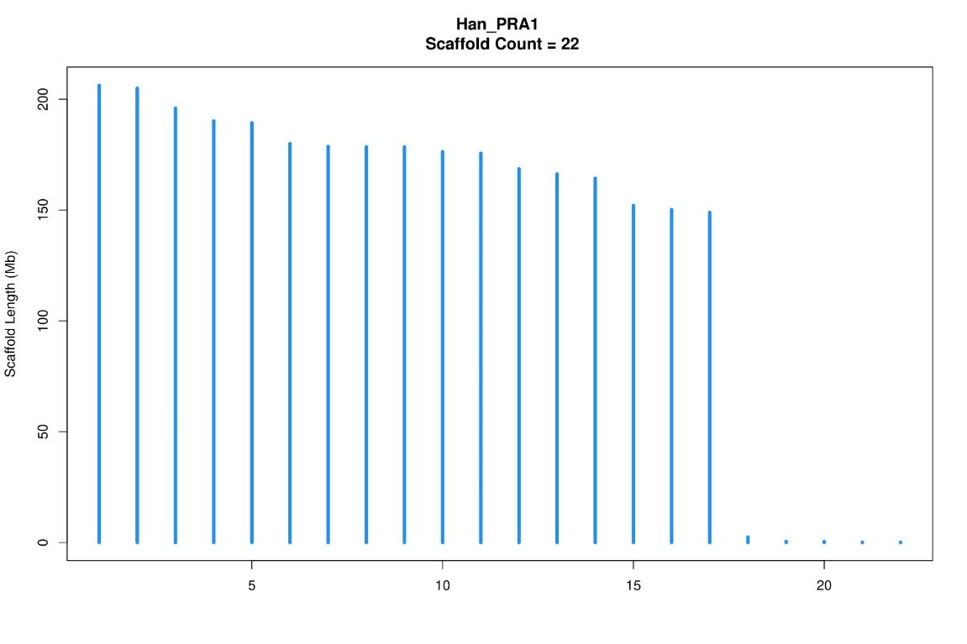
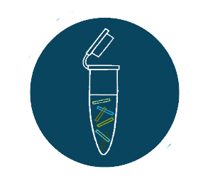
From the seed to the genome: Providing full solution to deliver high quality genome assembly
Nathalie Rodde, Caroline Callot, Stephane Cauet, Charlotte Cravero, Nicolas Théron, William Marande, Nadine Gautier, Nadège Arnal, Elisa Prat, Anthony Théron, Isabelle Dufau, David Pujol, Margaux-Alison Fustier, Arnaud Bellec and Sonia Vautrin
Relying on a 15 years expertise in plant genomics and especially in high quality DNA production from plants, the CNRGV offers a full solution to deliver high quality genomes assemblies. We are in charge of projects from seeds or plants and manage all the steps from the HMW DNA production to the data assembly. We combine complementary technologies such as PacBio HiFi reads and Bionano optical maps. We have developed versatile pipelines to reach chromosome level assemblies that give the possibility to integrate data from a reference genome or genetic maps. We provide additional analysis such as annotation and structural variation detection.
Collaborators
In-house seed growing service to ensure an optimal plant material for HMW and uHMW DNA production from various species
CNRGV’s Plant
growing facilities
Combining PacBio and Bionano technologies to reach the chromosome level: example of sunflower
Several protocols adapted to each plant species
Fragments size :
From 50 to 200kb
Several protocols adapted to each plant species
Fragments size :
From 100 to 1 500kb
u
Helianthus annuus cultivar. Estimated genome size : 3,2Gb - Estimated number of chromosome : 17
Sequencing library preparation (HiFi)
DNA labelling
Working on various species
 |  | Assemblies PacBio HiFi |  |  | Hybrid Scaffolds (HiFi + optical map)
Species | Estimated length | Contig nb | Total length (Mb) | N50 (Mb) | Scaffold nb | Total length (Mb) | N50 (Mb)
Eucalyptus* | 550 Mb | 659 | 962 | 8,52 | 72 | 1010 | 30
Barley | 5 Gb | 4 015 | 4 351 | 32,64 | 111 | 4 190 | 105
Rapeseed | 1,1 Gb | 2 152 | 1 068 | 8,4 | 42 | 1 005 | 56
Sunflower | 3,2 Gb | 592 | 3 042 | 34,8 | 21 | 3 003 | 177
Wheat | 15 Gb | 5055 | 14657 | 30 | 324 | 14 459 | 204
Einkorn wheat | 5,6 Gb | 1142 | 5149 | 54 | 24 | 5103 | 522
Rose* | 500 Mb | 1105 | 1024 | 9,5 | 61 | 967 | 26
Sequencing providers
HiFi reads - CCS
(Circular Consensus Sequence)
Yield : Up to 35Gb CCS 3 passes/SMRT cell
Long read lengths up to 25 kb
High read accuracy >99.9%
OPTICAL MAP DATA
Yield : Up to 2Tb/Flow-Cell
Molecule lenght : N50 up to 300kb
3 Flow-Cells / Chip
* Heterozygous species
We have developed several analysis pipelines dedicated to specific complex genomes. E.G. : For the rose sequencing project, we have worked on a haplotype separation method based on mapping and scaffolding with genetic map validation.
Minimum 20X coverage assembled using HiFiasm or Canu assemblers.
Minimum 60X effective coverage assembled with Bionano tools.
Genome data comparison and structural variation detection
SV
Chromosome level assembly
Genotype 1
Genotype 2
Secured storage and transfer of results
Example of SV detection (deletion) : Comparing genome data (assemblies or optical map) allow structural variation detection (indel, inversion) from kb to Mb scale.
Perspective ? Capture method with Xdrop technology (Samplix®)
Prerequisite :
Ultra specific PCR markers every 100kb max
Design on conserved sequences among genotypes to allow diversity analysis
On-going development :
First capture projects on sunflower and olive tree
Bioinformatics expertise : adaptation of existing pipeline for chimera identification and elimination
Targeted sequencing of regions with little prior knowledge on large panels
24 Chemin de Borde Rouge
Auzeville - CS 52627
31326 Castanet tolosan cedex FRANCE
Tél : 05.61.28.52.53
https://cnrgv.toulouse.inrae.fr
https://twitter.com/CNRGV

